Slide 1
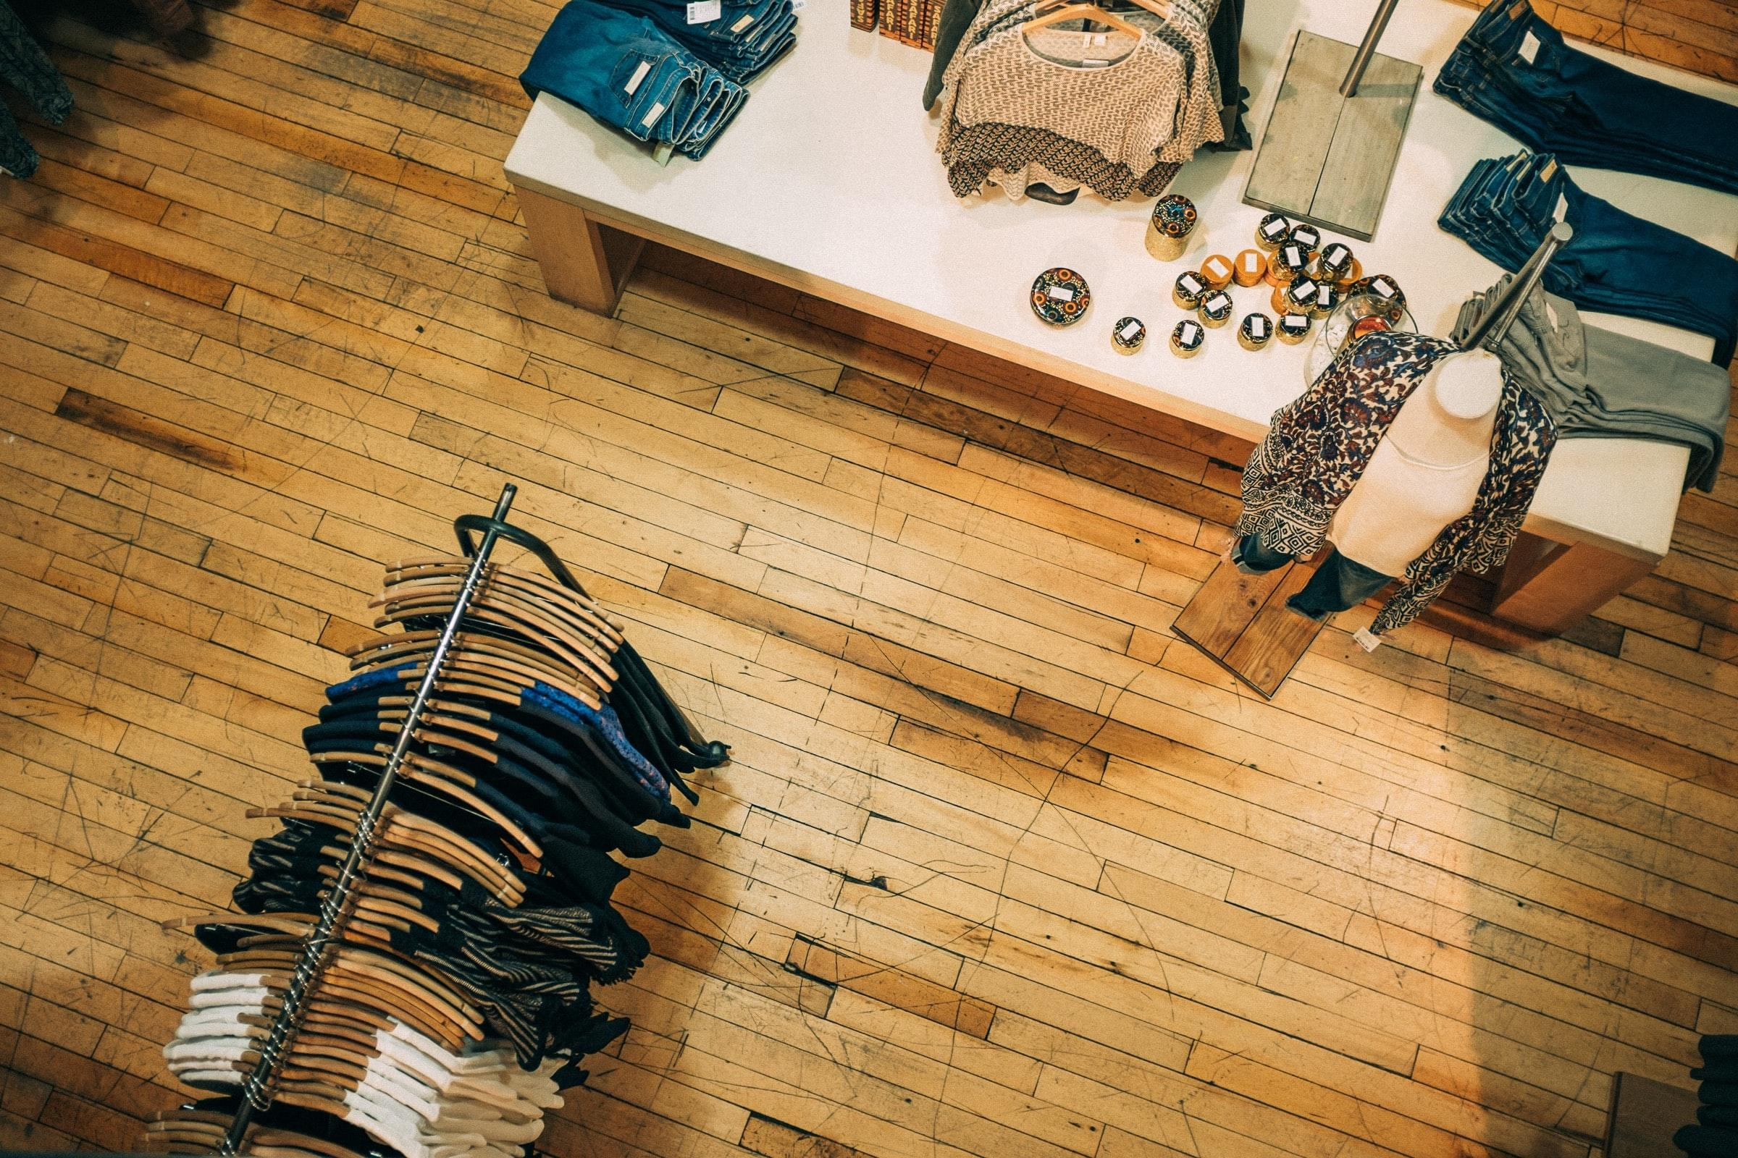
Fashion Brand Engagement via Image Analytics
Emilio Cabrera, Vishu Agarwal, Chaitra Setty, Ally McNulty, Yashpreet Kaur
Notes:
1 - 4 Emilio (1.5 min)
5 - 7 Chaitra (2 min)
8 - 9 Ally (1 min)
10 - 12 Vishu ()
13 - 17 Yashpreet

Slide 2



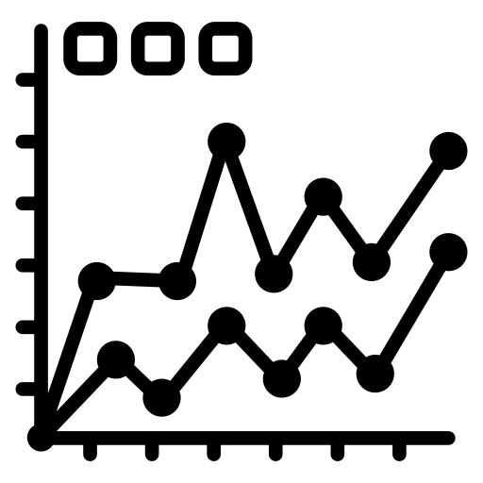

Agenda
Web Scraping & Data Cleaning
Conclusions
Business Problem
Topic Modeling
Predicting Engagement
Notes:
(Emilio)
Names
Today we will be presenting on Fashion Brand Engagement via Image Analytics
First we’ll go over our business problem / datasets, then we’ll go into our analyses for predicting engagement, and review our final conclusion

Slide 3
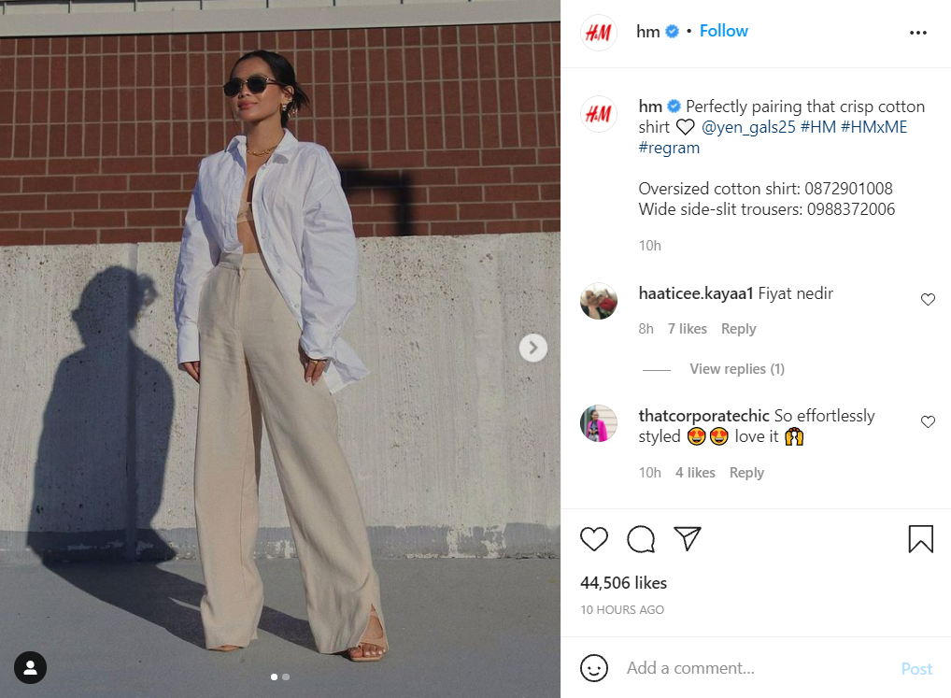
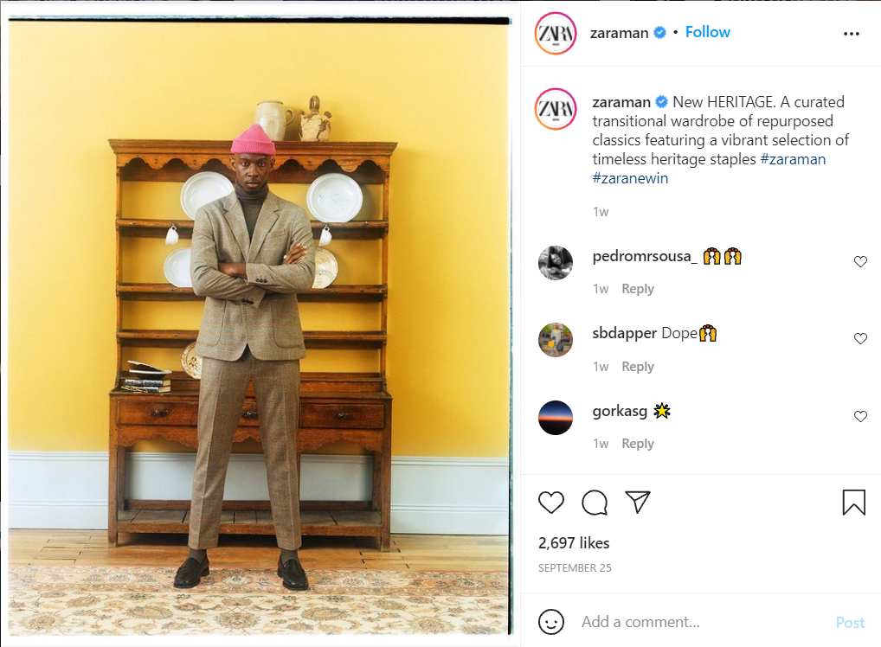
Business Problem
How to drive social media engagement on Instagram for fast-fashion brands?
Why this problem? Why H&M and Zara?
$872BN Projected size of the global online fashion market by 2023
74% of consumers rely on social networks to help them make purchase decision
69% of fast-fashion marketers plan to spend more on Instagram marketing than other platforms in 2021
60% of users discover new products using Instagram
Notes:
(Emilio)
The business problem we aimed to solve was: How to drive social media engagement for fashion brands with gender related products?
Why this problem?
We looked into two specific brands: Zara & H&M
Why did we select Zara & H&M? They are both...
International / renowned brands
Large social media presence...a lot of followers
Fast fashion ⇒ inexpensive / trendy clothing produced rapidly by large retailers

Slide 4


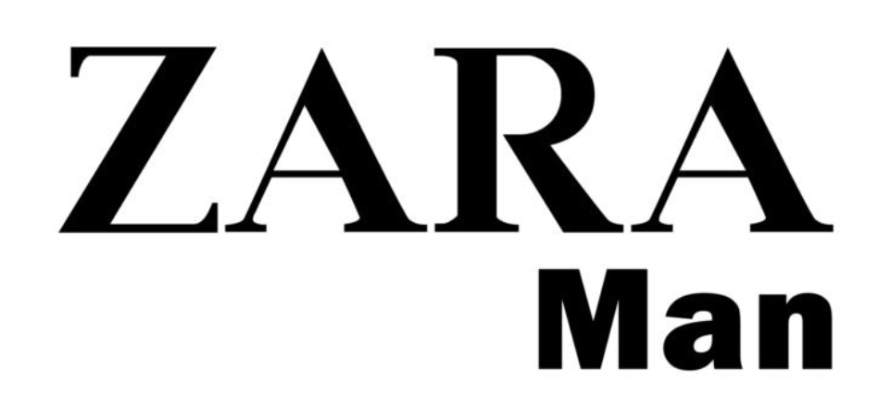

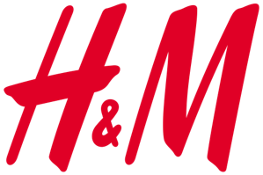
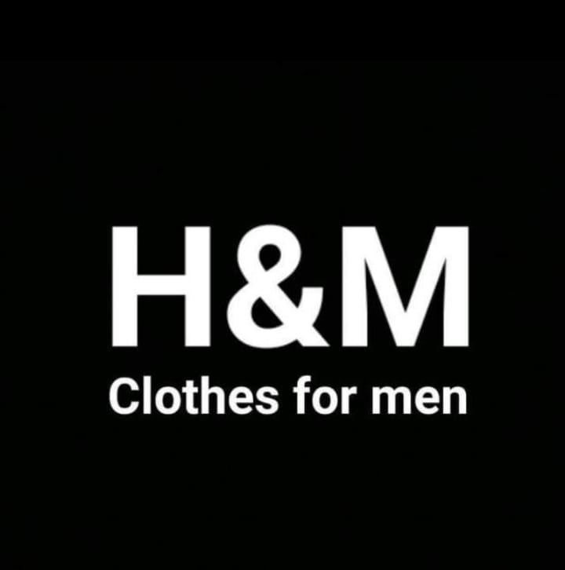
Data Aggregation
Instagram
Fashion Brands
Google’s Image Analytics API
Image
# of Likes
# of Comments
Parent
Men
Notes:
(Emilio)
In order to analyze this problem, we headed to instagram where we scraped the most recent 250 posts (image, #comments, #likes)
For Zara, H&M, and their respective men’s pages. 4 accounts total
Utilizing Google’s Image Analytics API, we identified certain labels in each posts
Now i’ll hand it off to Chaitra to discuss our LDA analysis

Slide 5
Topic modeling - Latent Dirichlet Allocation (LDA)
What works well for brands with high Instagram engagement?
: 47M followers
: 37M followers
Notes:
(Chaitra) We tried couple of iterations with different values of alpha and eta and this is what gave us the most distinct topics.

Slide 6
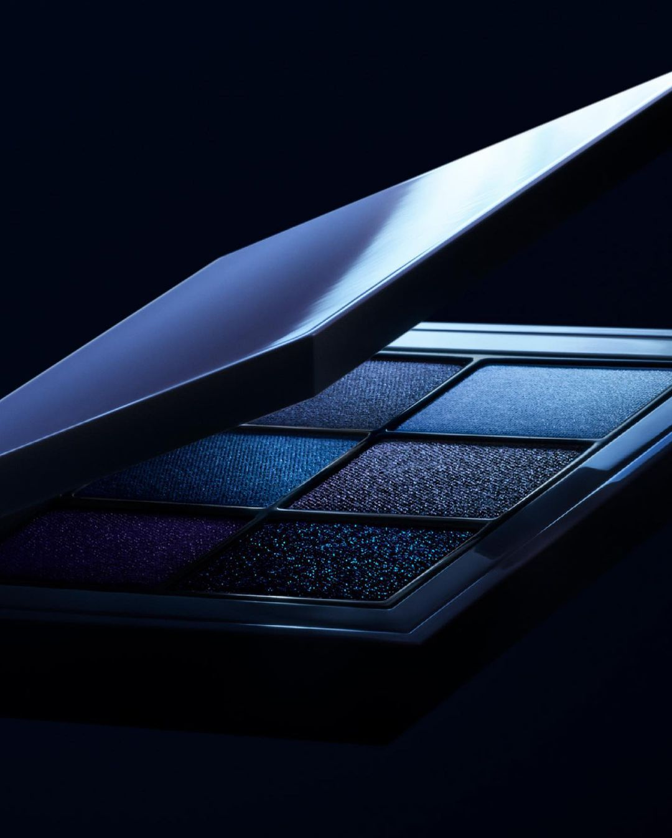
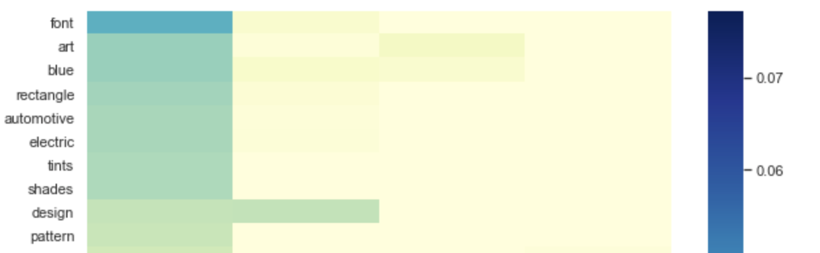
Parent Page’s Topics
Cosmetics
Key Labels
Art
Tints
Design
Pattern
Notes:
(Chaitra) (Slides 6-9) Based on the topic modeling analysis, we found the following 4 main topics that drive high engagement on the parent pages: Cosmetics, Sexy, Face, Outdoors

Slide 7
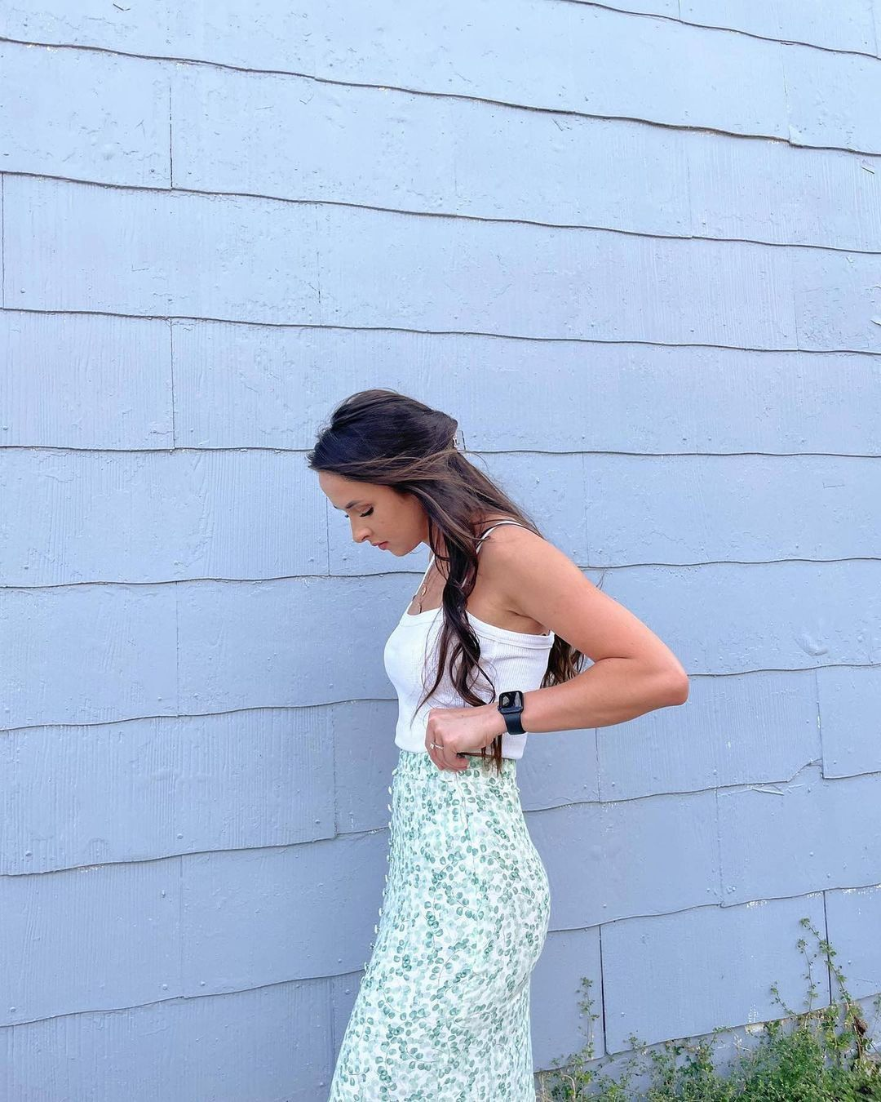
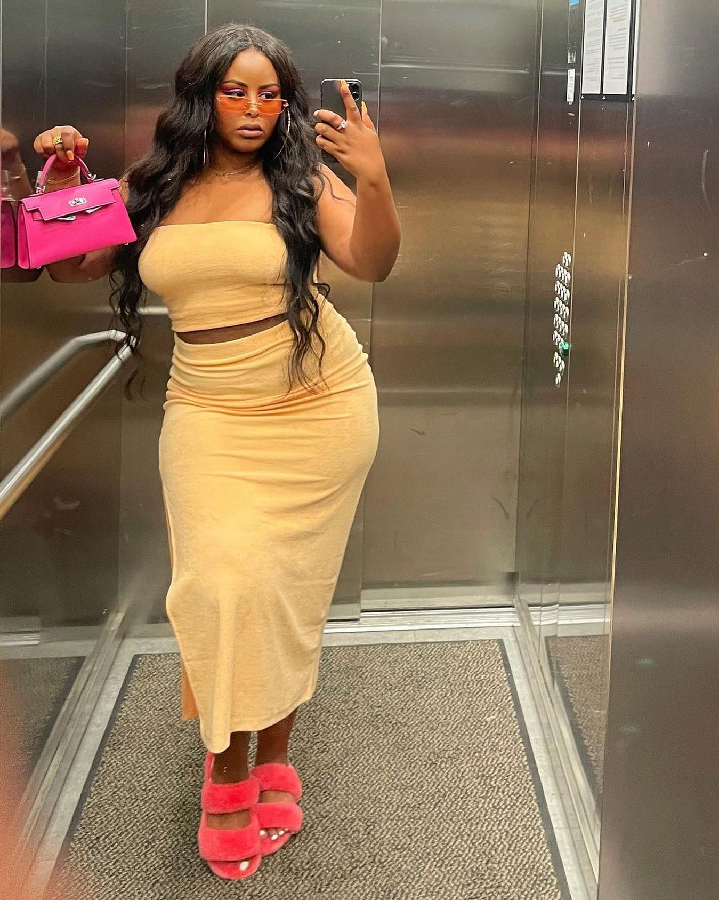
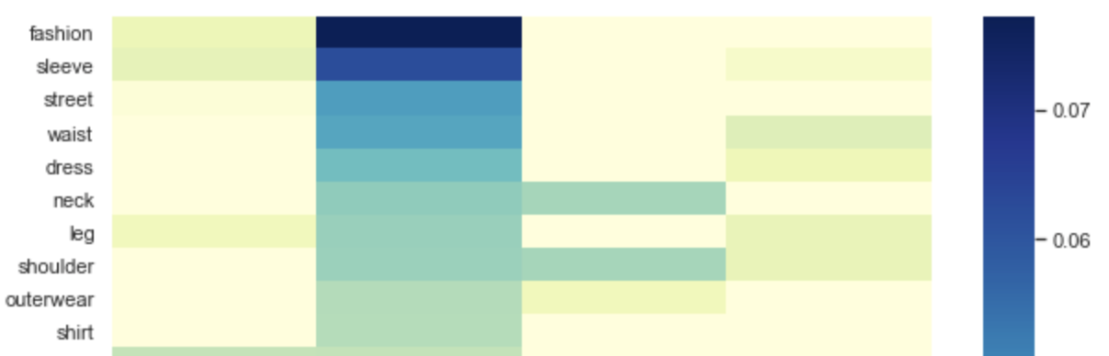
Parent Page’s Topics
Sexy
Key Labels
Waist
Leg
Dress
Shoulder
Neck
Sleeve
Notes:
(Chaitra)

Slide 8
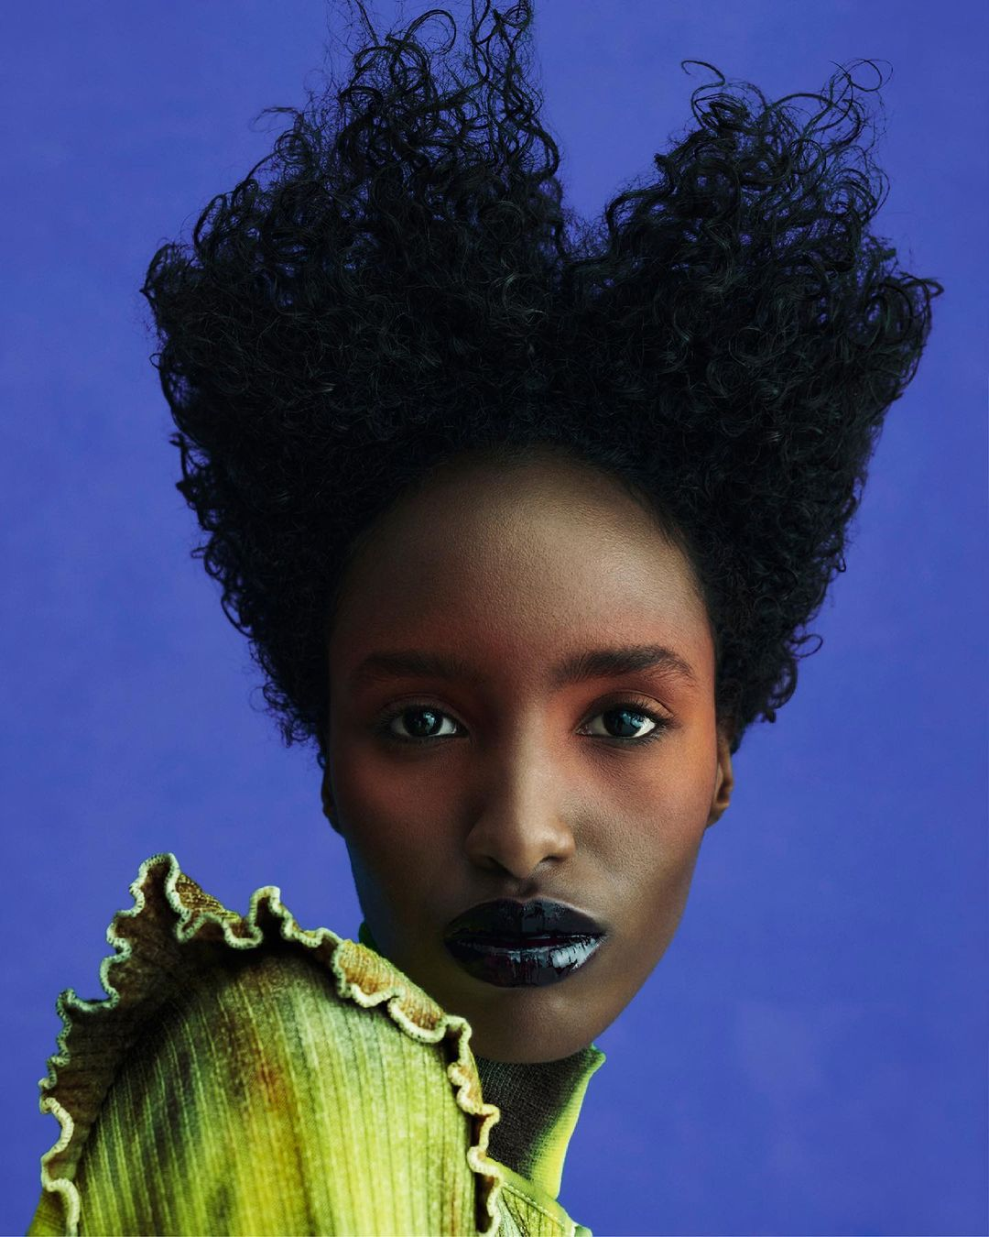
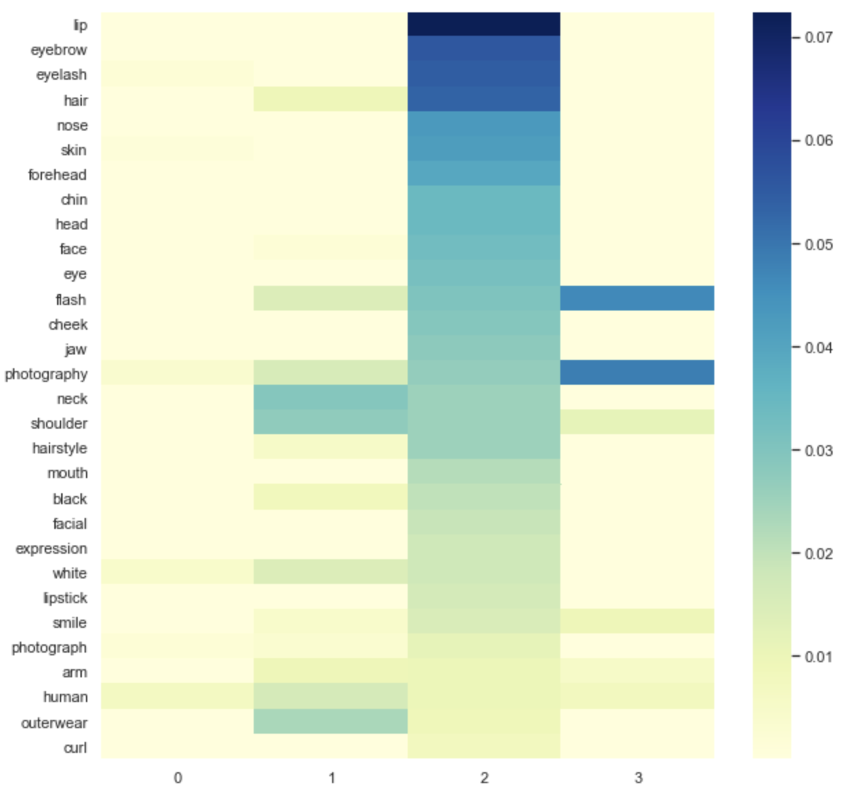
Parent Page’s Topics
Face
Key Labels
Lip
Eyebrow
Eyelash
Chin
Hair
Chin
Notes:
(Chaitra)

Slide 9

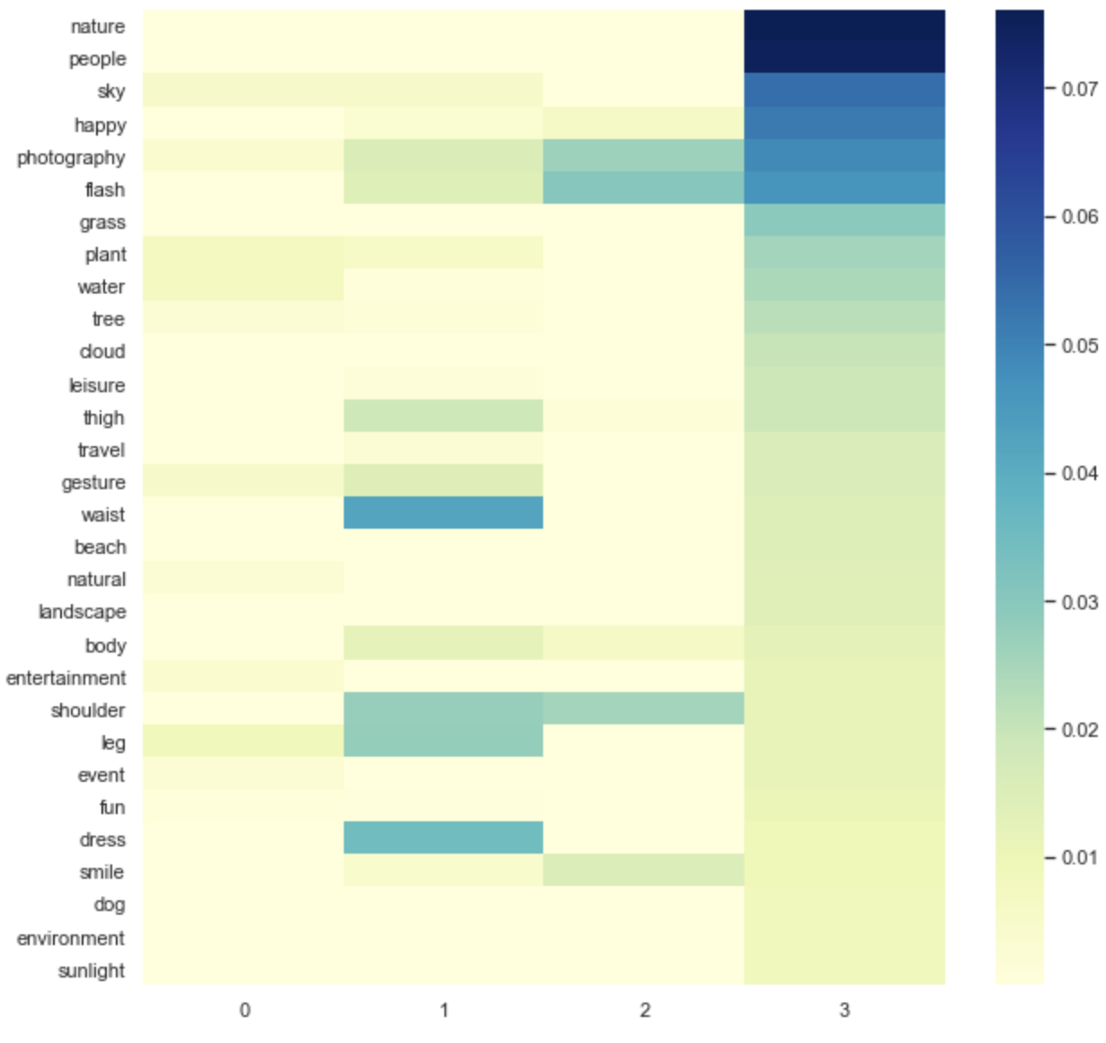
Parent Page’s Topics
Sustainable
Key Labels
Nature
People
Sky
Grass
Plant
Tree
Notes:
(Chaitra)

Slide 10
Topic modeling - Latent Dirichlet Allocation (LDA)
Is there a different engagement strategy for men’s wear?
: 567K followers
: 2.2M followers
Notes:
(Ally)

Slide 11
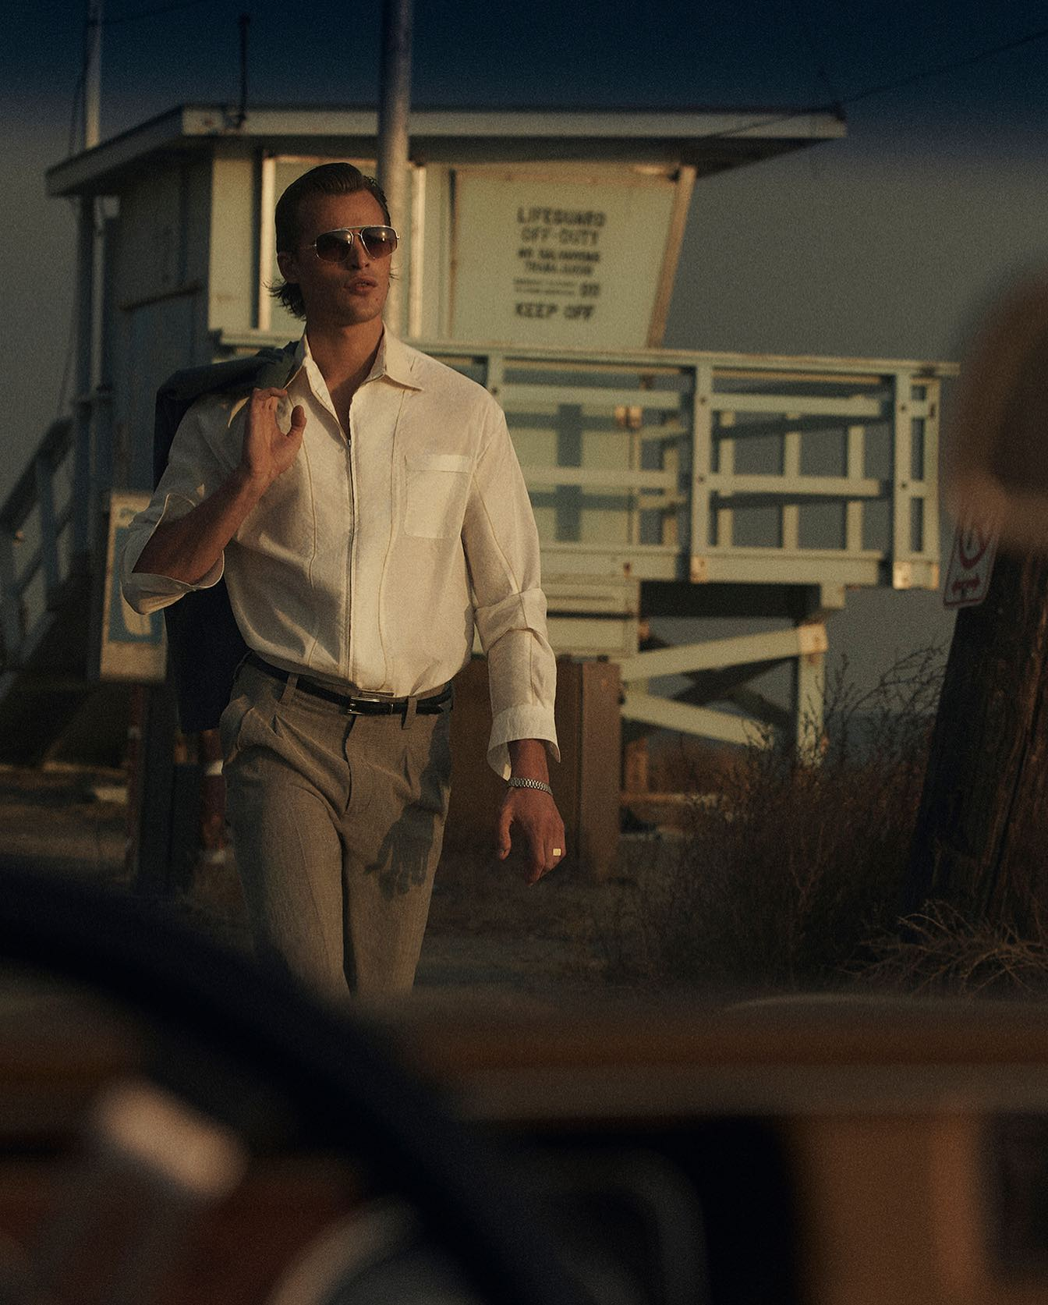
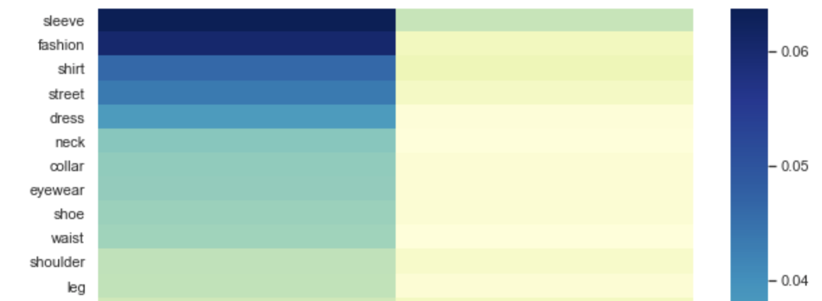
Analysis: Men’s Topics
Mens Page’s Topics
Swag
Key Labels
Street
Eyewear
Fashion
Shoe
Collar
Sleeve
Notes:
(Ally) As mentioned by XXX, we ran image analytics on all of these pages and identified the top 2 topics for the men’s pages. The topics that we found are: swag and athletics.
Swag: This topic involved images that had sunglasses, shoes, streetwear
Athletics: This topic includes images that have bicycles, surfboards, basketball courts

Slide 12
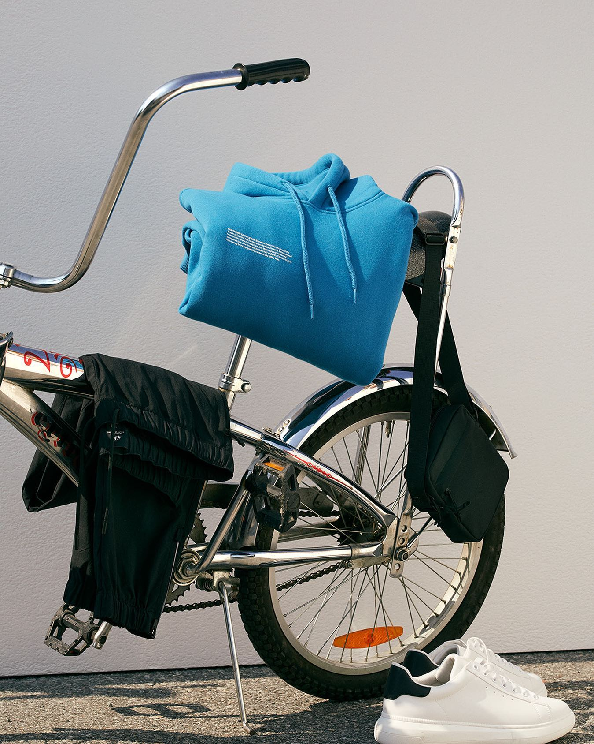
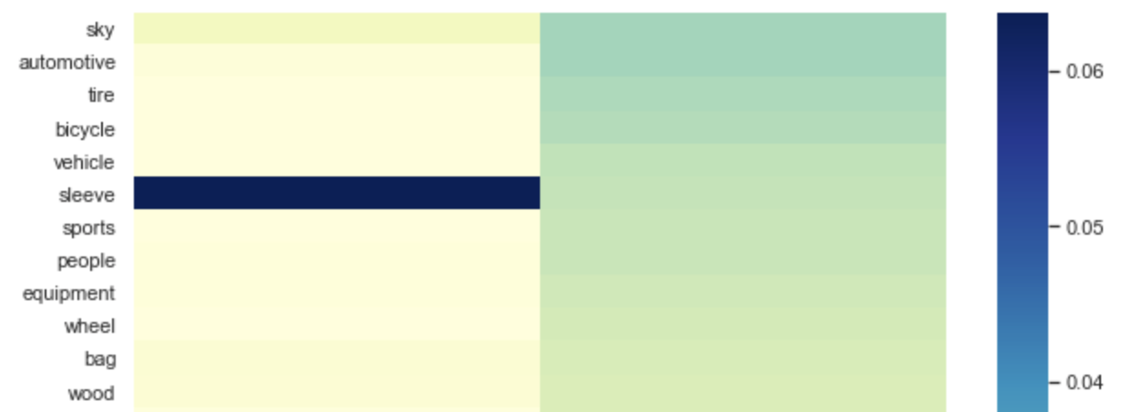
Analysis: Men’s Topics
Mens Page’s Topics
Athletics
Key Labels
Bicycle
Sports
Bag
Equipment
Tire
Automotive
Notes:
(Ally) As mentioned by XXX, we ran image analytics on all of these pages and identified the top 2 topics for the men’s pages. The topics that we found are: swag and athletics.
Swag: This topic involved images that had sunglasses, shoes, streetwear
Athletics: This topic includes images that have bicycles, surfboards, basketball courts

Slide 13
How are Parent vs. Men’s pages driving the engagement differently?
versus
Notes:
Vishu

Slide 14
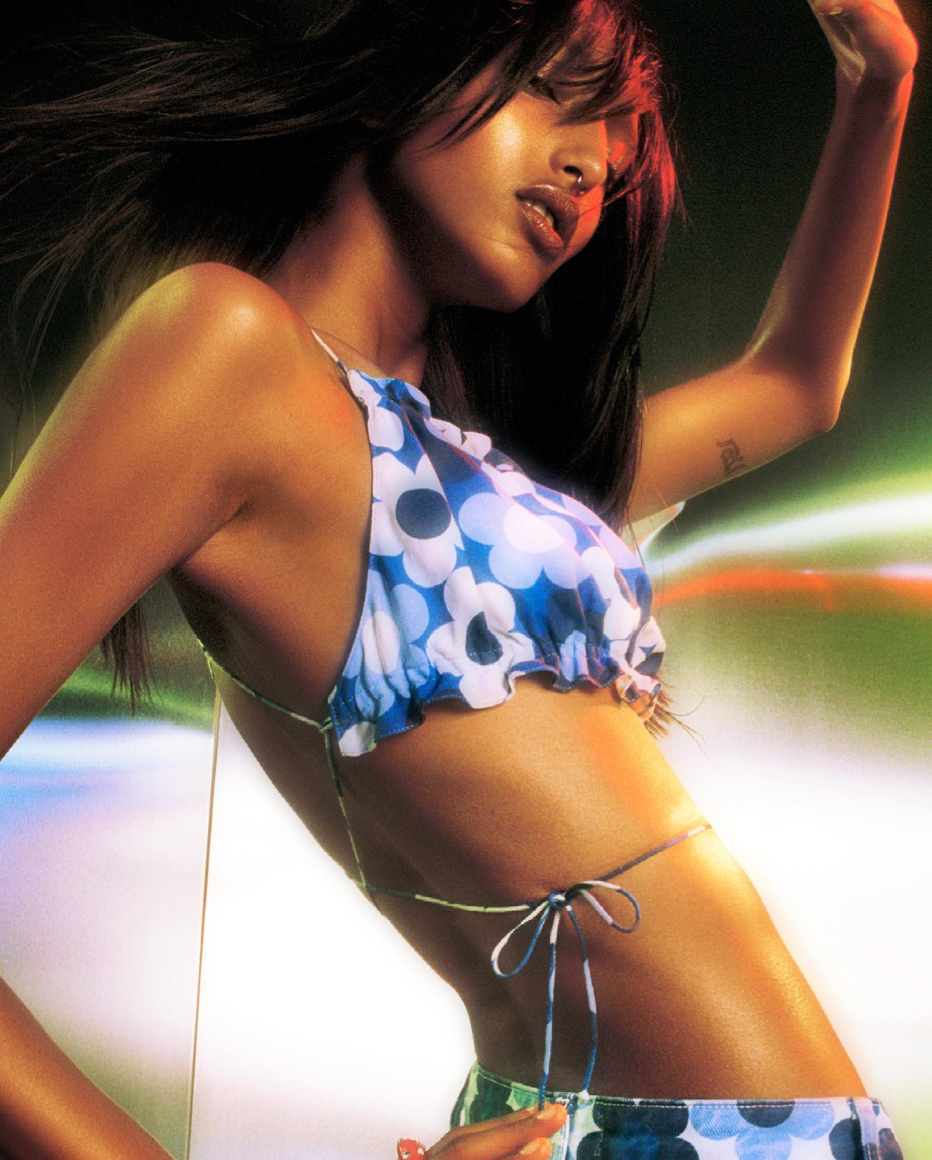

These are the images with highest Engagement Score
Engagement Score = (Normalized Comments) 60% + (Normalized Likes) 40%
*Greater than 50% of median value, then 1, else 0
Notes:
Vishu

Slide 15
Posts with highest engagement - What are they about?
Instagram Page | Topics | Average association
Parent Page | 1. Sexy | 60%
 | 2. Cosmetics | 17%
 | 3. Nature | 13%
 | 4. Face | 10%
Men’s Page | 1. Swag | 80%
 | 2. Athletic | 20%
Notes:
Vishu

Slide 16
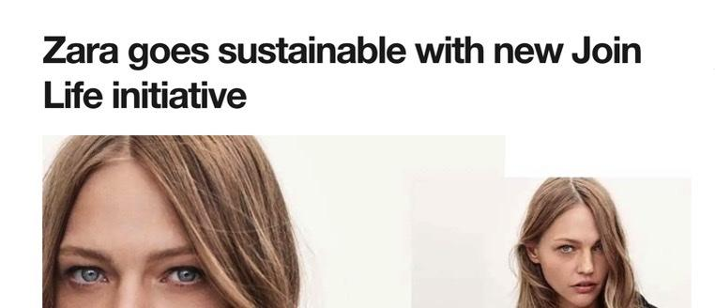
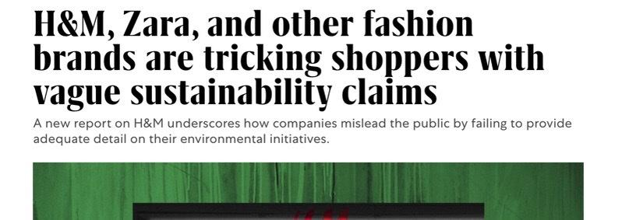
Why a sudden focus on nature/life/organic?
Did it work?
Among lowest engagement quartiles
Ahaa…?
Notes:
Vishu

Slide 17
Predicting Instagram Engagement
Will the next Instagram post of
have high engagement?
Notes:
Yashpreet

Slide 18
Regression Analysis (including PCA)
Model description:
Predictors: TF-IDF word vector (from output of Google Image Analytics)
Response: Engagement score (1 >= median value of calculated engagement score,
0 < median value of calculated engagement score)
# Features | Captions | Labels | Labels & Captions
Before PCA | 2407 | 515 | 2760
After PCA | 400 | 250 | 430
Accuracy | 63% | 60.4% | 67.3%
Notes:
Yashpreet

Slide 19
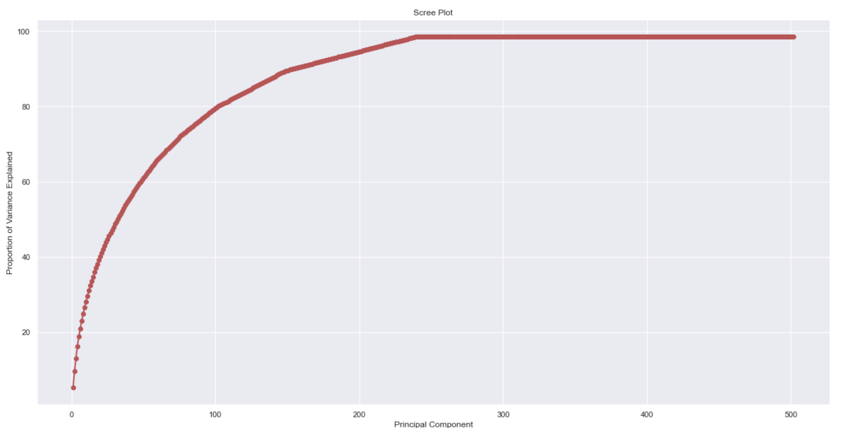
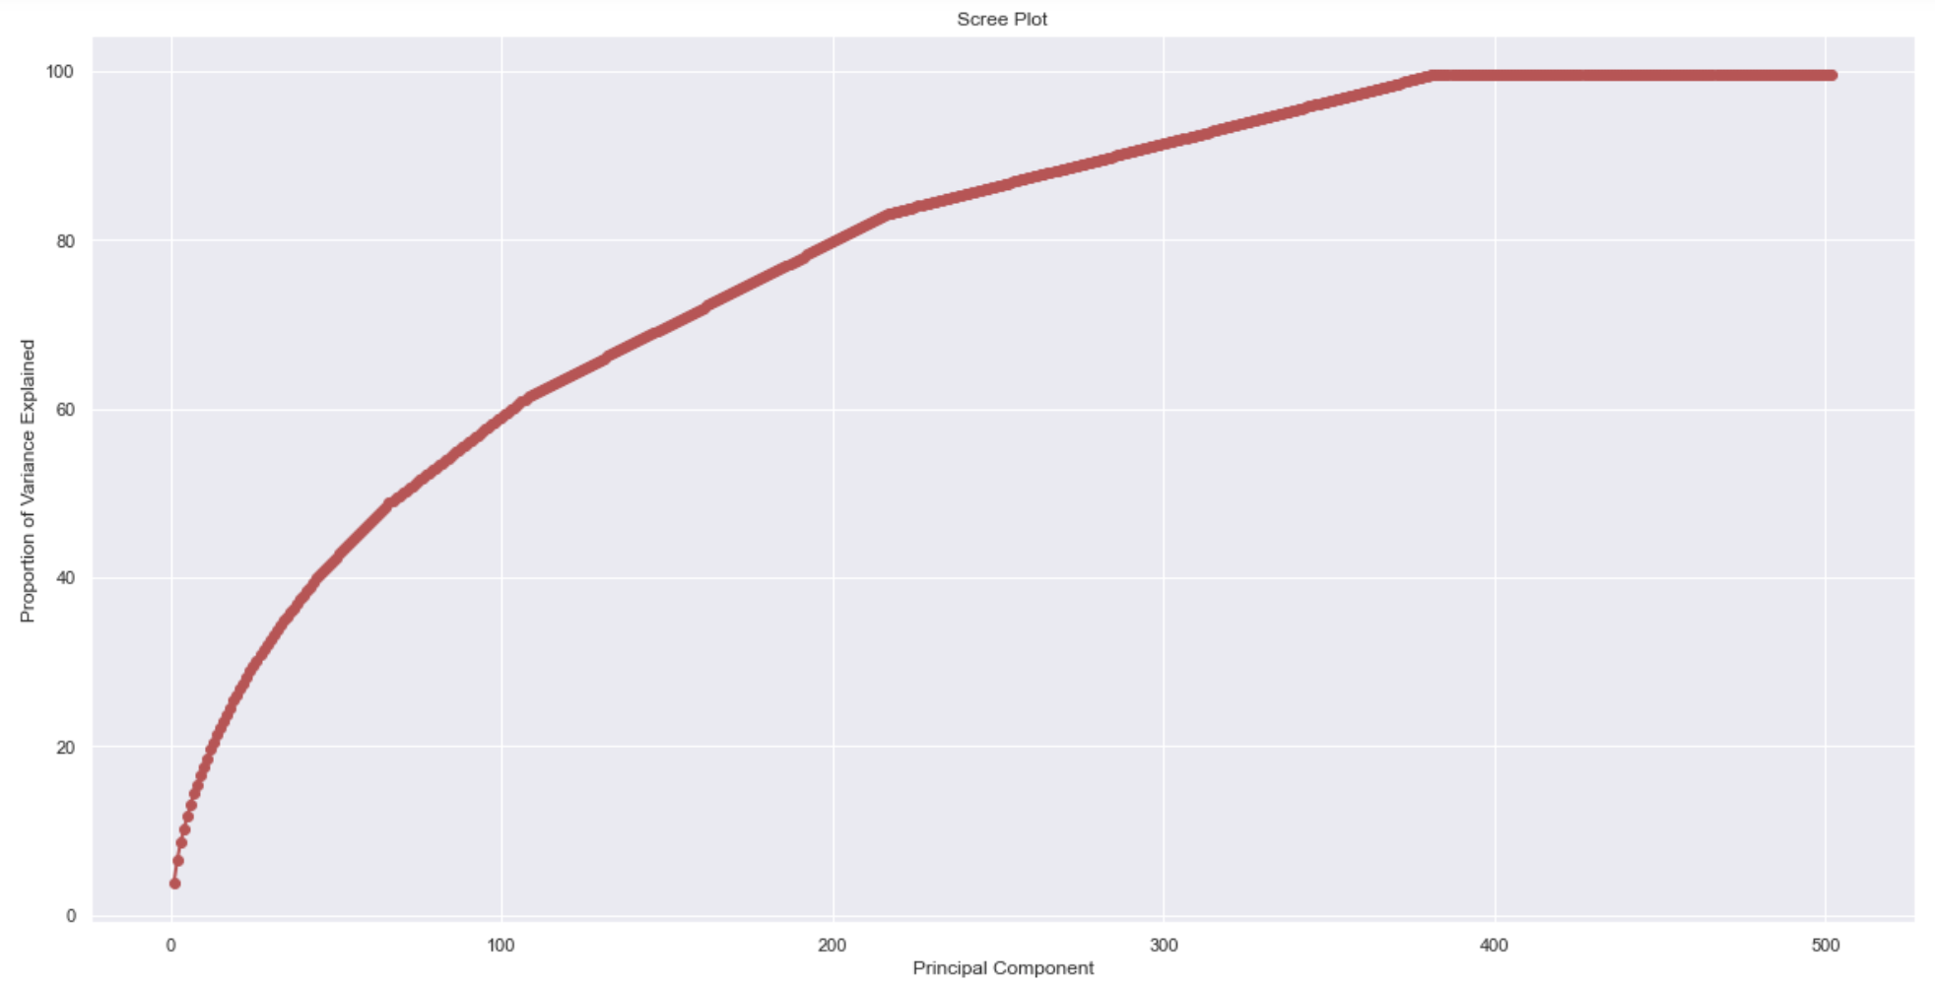
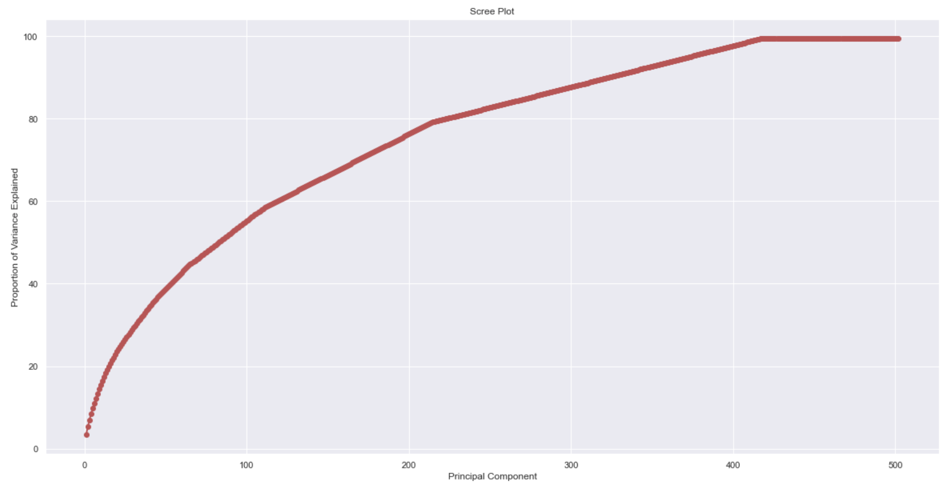
Scree plots for choosing #features in PCA
Fig 1: Scree plot for labels (n = 250)
Fig 2: Scree plot for captions (n = 400)
Fig 3: Scree plot for labels + caption (n = 430)
Notes:
Yashpreet

Slide 20
Conclusion
What next...
Top topics for fashion brands with high Instagram engagement:
Parent fashion brands (Sexy, Cosmetics)
Men’s fashion of these parents (Swag)
To predict whether the next Instagram post of these brands will have high engagement:
Labels and Captions model has the highest model accuracy of 67.3%
Identify what topics can be focussed on by brands which have lower Instagram engagement (Forever 21 - 14.5M followers, UniQlo - 2M followers)
Notes:
Yashpreet

